Slide 1

Department of Buildings and General Services
2 Governor Aiken Avenue – Montpelier, Vermont
Vermont Information Centers Division
Fiscal Year 2016 - Annual Report
Government Business Services Directorate
September 14, 2016
Notes:
1

Slide 2
Vermont Information Centers Division
Mission
Authority
Program History
Program Overview
Key Result Areas
  People
  Communication
  Finances
  Operations
  Security

Slide 3
Mission…
Vermont Information Centers Division
BGS Mission -- The employees of Buildings and General Services work together to deliver quality services and provide facilities management, enabling government to fulfill its mission.
VICD Mission
  Provide travel information and a safety break to travelers that is accountable and fiscally responsible
  Serve as Vermont’s Billboards
    Promote the “Vermont Experience” by marketing Vermont’s businesses, attractions and events to the traveling public

Slide 4
Authority…
Vermont Information Centers Division
1992 | Act 144 | Sec. 49 | Operation authority transferred from VTrans to ACCD
1993 | Act 59 | Sec. 4d | Information re Recreational Vehicles
1993 | Act 59 | Sec. 7c | Close Putney, Coventry, Fairfax (northbound)
1994 | Act 233 | Sec. 42a | Keep open and operate Coventry and Georgia Northbound
1995 | Act 60 | Sec. 15 | SW Vermont (Bennington) Welcome Center
1995 | Act 60 | Sec. 7c | Renovations/construction of 7 rest areas: Derby, Lyndon, Waterford, Randoph North and South, Highgate, Fair Haven. Closure of 7 rest areas: Coventry, Westminster, Georgia North, Fairfax South, Sharon North, Sharon South, Bradford South.
1996 | Act 183 | Sec. 12 | Raze Bradford South and Coventry North; continue operation of Sharon North; completion of 7 rest areas; upgrades to Fair Haven, Lyndon, Waterford; study committee to investigate Fairfax SB, Georgia NB, and Highgate.
1996 | Act 62 | Sec. 33 | Land purchase; Alburgh
1997 | Act 38 | Sec. 19e(c) | Authority to enter into agreements and grant funds to location or regional chambers of commerce
1999 | Act 18 | Sec 39 | BGS authorized to operate as state or private facilities
1999 | Act 18 | Sec. 39 | Design Bennington Welcome Center
1999 | Act 18 | Sec. 39 | Investigate continued operation of Sharon South
1999 | Act 18 | Sec. 41t. | White River Junction downtown information center pilot
2002 | Act 141 | Sec. 11 | Decrease funding for Bennington Welcome Center

Slide 5
Authority… (continued – 2 of 3)
Vermont Information Centers Division
2003 | Act 19 | Sec. 4(a) | Sale of Vermont Products
2003 | Act 56 | Sec. 59 | Motorist Aide Refreshment Program
2003 | Act 63 | Sec. 160b | Sale of milk and milk products
2004 | Act 160 | Sec. 34 | Study of information center funding
2005 | Act 80 | Sec. 12 | Hartford sewer line
2005 | Act 80 | Sec. 13 | Monuments to builders of VT interstate system
2005 | Act 80 | Sec. 14 | Design basic rest area and information center
2006 | Act 147 | Sec. 12(d) | VT State Police outpost
2006 | Act 175 | Sec 60 | VICD Funding from General Fund
2006 | Act 175 | Sec. 59 | Rest Area Advisory Committee is created (19 VSA, Section 12c)
2007 | Act 52 | Sec 31 | Lease space, sell products…within limits of federal Surface Transportation Act and Randolph-Sheppard Act
2009 | Act 50 | Sec 105 | Rest Area Commercialization -- seek FHWA waiver
2009 | Act 50 | Sec 106-110 | permanent closing of facilities; hours or operation; pilot projects; operations of information centers; Bennington construction

Slide 6
Authority… (continued – 3 of 3)
Vermont Information Centers Division
2010 | Act 123 | Sec. 51 | Pursue private-public partnership at Exit 7 of I-91
2010 | Act 123 | Sec. 52 | Cross-Border Opportunities
2010 | Act 123 | Sec. 55 | Repeal of Rest Area Advisory Committee
2011 | Act 40 | Sec. 32 | Summer Study - Future Vision for VICD (BGS/VTrans/ACCD
2011 | Act 62 | Sec. 27 | Apportionment Study
Title 3 | Chap. 47 | Sec. 2476 | Brochure distribution

Slide 7
Program History…
Vermont Information Centers Division
1960s and 1970s – Vermont Agency of Transportation
  Built and operated rest areas
  Federal interstate system expanded across the country
  Mission to provide rest rooms and safety breaks
Traffic Volumes Increase at Rest Areas
  1960s and 1970s – 50 to 100 visitors per day at a site
  Today – 500 to 3000 visitors per day at a site
    More during holiday travel
  Increased traffic valuable to Vermont’s tourism industry
  Increased traffic accelerated the deterioration of facilities

Slide 8
Program History… (continued)
Vermont Information Centers Division
1992 – Commerce & Community Development
  Manage highway information centers
  Expanded mission to provide tourism information to travelers
  Challenged with maintenance and operations of failing systems.
1997 – Buildings & General Services
  Management transferred to Buildings & General Services
  Expedite upgrade of facilities from rest areas to Information and Welcome Centers
Funding
    Currently Funded 86% Transportation Fund and 14% General Fund
    Funded through General Fund for FY 2007 thru FY 2011
    Funded through Transportation Fund until FY 2007

Slide 9
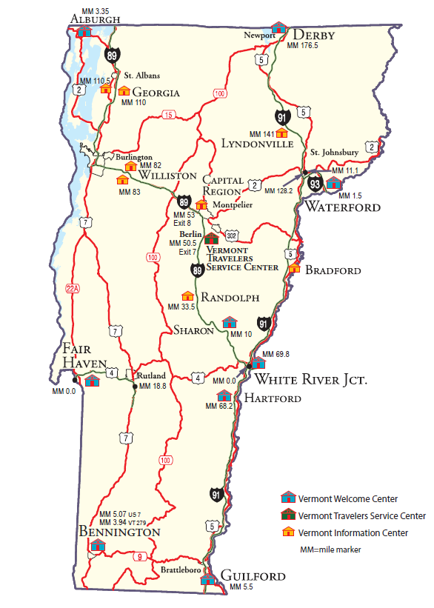
Program Overview…
Vermont Information Centers Division
18 Information/Welcome Centers
  4 Sites Closed February 2009*
3 Supervisory Districts
29 Classified Employees
33 Temporary Employees
23 Chamber Employees
Hours of Operation Vary **
  9 facilities reduced to 12-hour days in 2009
Predominantly single-layer staffing
318 Miles of Interstate Highway
Transportation/General Fund Program (86% TF/14% GF)
Division Website: http://bgs.vermont.gov/information_centers
1 Public-Private Partnership at Exit 7, Berlin
  Scheduled to open September 2, 2016
  Services available 24 hours/day; 365 days/year
* 4 facilities closed in February 2009: Highgate, Hartford North, Randolph North, Sharon South
** 4 facilities operate 16 hours/day (Guilford, Sharon, Williston North, and Williston South); since 2009-08-16, hours at 9 facilities reduced to 12 hours/day (Derby, Lyndon, Bradford, Georgia North and Georgia South, Waterford, Randolph, Fair Haven);Hartford and Bennington operate 14 hours/day; Alburgh and White River 8 hours; Montpelier 11 hours.

Slide 10
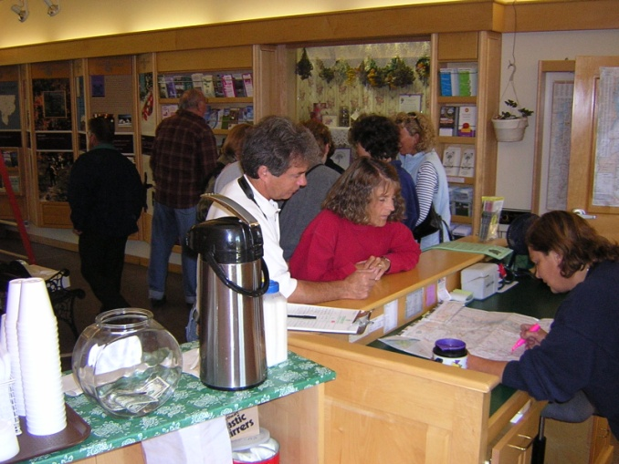
Program Overview… (continued)
Vermont Information Centers Division
VICD sites provide:
  Local and regional travel information
  Safety breaks and restrooms
  Free Green Mountain Coffee Roasters coffee
  Knowledgeable employees
  Lodging reservations
  Statewide event listings
  Free wireless internet access
  Access to information kiosks

Slide 11
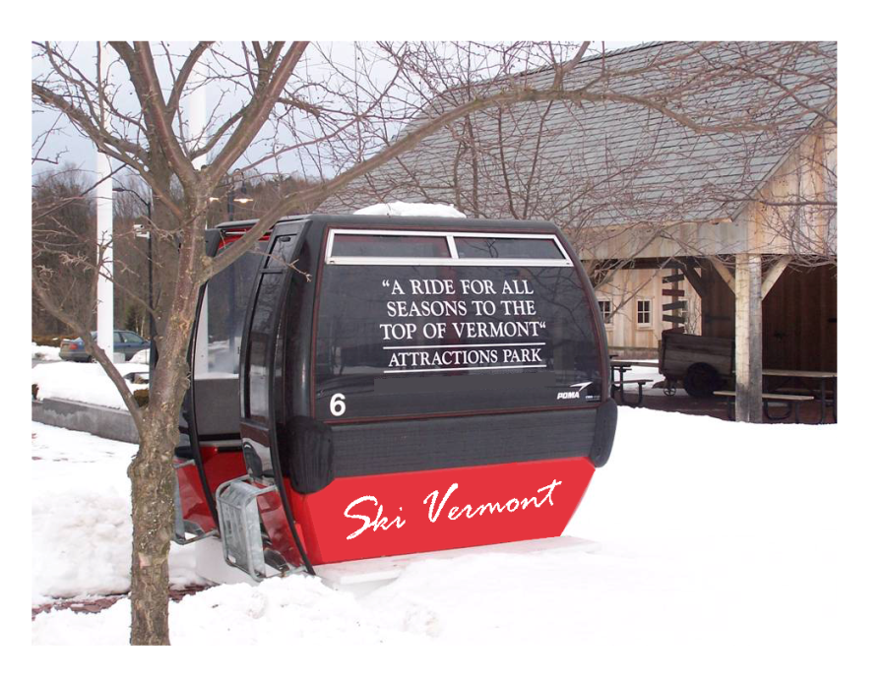
Program Overview… (continued)
Vermont Information Centers Division
Promote the Vermont experience to our visitors through:
  Statewide brochure distribution
  Free display space
  Live demonstrations
  Event banner display
  Event promotions
  Visitor referrals
  Promotional display panels
  Static Interactive Displays

Slide 12
Key Result Areas
Vermont Information Centers Division
People -- Employees, Customers, Stakeholders
Communications -- Employees, Customers, Stakeholders
Finances
Operations

Slide 13
People
P1 - Goal
Vermont Information Centers Division
P1 – Provide employees with effective leadership
  Commitment to BGS Core Values
  Quality and timely evaluations, feedback, training, and mentoring
  Fair and deserving recognition

Slide 14
People
P1 - Performance Measure
Vermont Information Centers Division
Performance Evaluation Data tracked and provided by DHR.
Incidence of disciplinary issues - data tracked and provided by DHR.

Slide 15
People
P2 - Goal
Vermont Information Centers Division
P2 – Provide training, resources, education, equipment and support required for employees to succeed in their mission.
  Ensure employees are knowledgeable of VICD-BGS-State policies, rules, and regulations.
  Provide BGS- and State-required training
  Provide job-specific VICD training on all Ambassador levels to supervisors and field staff.
  Encourage networking with state stakeholders and peers on a national level.

Slide 16
People
P2 – Program Information
Vermont Information Centers Division
Training Component/Quality Control
Reinforce Division goals and missions
Measure, clarify, and unify standards
Provide a common level of understanding about the services we provide
  Customer Service (2004-2007)
  Interpersonal Skills (2005)
  Team Building (2006)
  VICD Ambassador Program (2006-2007)
  Online Ambassador Certification Program (2010-2015)
  Byways Testing – Team Training (2011)
  Take This Job & Love It – Moving Thru Change (2012)

Slide 17
People
P2 – Program Information
Vermont Information Centers Division
Ambassador Training Program
FY 2015
During FY 2015, 26 new Ambassadors were certified, in collaboration with VDTM.
There are a total of 122 trained Vermont Ambassadors in Community Information Centers (CIC)
  An estimated 60 Community Information Centers exist throughout Vermont.
  These CIC employees do not participate in the National Certification Program
An annual training package for VICD employees generally offers up to 15 new training modules.
National Certification in FY 2014
It is expected that VICD employees will participate in a 2019 national recertification.
During FY 2014, VICD Ambassador Training Program was awarded national certification through the National Council of State Tourism Directors (NCSTD)Travel Counselor Certification Program. NCSTD is a chapter of the U. S. Travel Association in Washington, DC.
  42 VICD Employees volunteered and successfully completed the National Certification test in 2014.
  21 employees from Williston, Georgia South, and White River Junction sites (staffed by grant/contract) also completed the certification test.
Community Information Centers
VICD Training Team collaborates with the VT Department of Tourism to provide training for hospitality businesses throughout the State, enabling them to be recognized a Community Information Centers and focusing on key customer-oriented employees.

Slide 18
Communications
C1 - Goal
Vermont Information Centers Division
C1 – Provide employees with open and honest communications concerning program operations.
  Share performance measurements at regular intervals
  Share current program updates/changes
  Weekly work plan review between supervisor and staff
  Timely and appropriate supervisory feedback
  Share site inspection reports with staff

Slide 19
Communications
C2 - Goal
Vermont Information Centers Division
C2 -- Develop and Maintain Consistent Processes/ Procedures to ensure VICD has an effective comprehensive communications strategy.
  Daily check-in call with Supervisors
  Daily reports from each site
  Weekly site inspections
  Weekly reports from each site
  Weekly reports to Commissioner
  Routine update of site profile
  Routine update of VICD spreadsheet

Slide 20
Communications
C3 - Goal
Vermont Information Centers Division
C3 – Provide management with timely and accurate reporting of program operations
  Daily supervisor contact with Supervisor and Director
  Weekly report from Supervisor
  Periodic meetings related to projects, etc.

Slide 21
Communications
C4 - Goal
Vermont Information Centers Division
C4 – Provide stakeholders (chambers, attractions, businesses, and communities) with regular feedback on how they can take advantage of VICD opportunities through:
  Website
  Periodic listserve notices
  Timely follow-up on inquiries
  Public speaking

Slide 22
Finances
F1 - Goal
Vermont Information Centers Division
F1 – Develop and implement strategies, procedures, and processes to effectively manage program expenditures and revenues by tracking
  Monthly expenditures
  Daily visitor counts
  Daily water counts
  Visitors by specific time periods
  Analyze monthly financial reports
  Review all invoices for expenses
  Review monthly Purchasing Card purchases

Slide 23
Vermont Information Centers Division
Finances
F1 - Performance Data
VICD Funding & Expenditures – FY 2012-2015
Funding: Transportation Fund (86%) and General Fund (14%) since FY 2013

Slide 24
Finances
F2 - Goal
Vermont Information Centers Division
F2 – Manage a successful Brochure Program
  Monitor rates, revenue, and usage
  May 1, 2014 to April 30, 2015 (“brochure year”)
    520 individual pieces registered
    46 new registrants
  Over 2,300,000 brochures and publications distributed
    Potential to reach over 3,300,000 visitors at VICD sites
NOTE: The “brochure year” (registration period) runs from May 1 to April 30 each year.

Slide 25
Brochure Revenues & Expenses - FY 2012-2016
Vermont Information Centers Division
Finances
F2 - Performance Data
Since 2003 inception: Total revenue : $2,878,999 Total net income: $548,794

Slide 26
Vermont Information Centers Division
Finances
F2 - Performance Data
Advertising Panel Sales Revenue FY 2012 – FY 2016
Special Funds: Information Centers Revenue Fund (includes Ad Panel Sales)
    Ad panels at seven VICD locations: Bennington, Derby, Fair Haven, Guilford, Hartford, Randolph, Sharon

Slide 27
Finances
F3 - Goal
Vermont Information Centers Division
F3 – Manage and provide oversight for the Coffee Program
  Monitor donations and expenditures
    Offered to promote traveler’s safety break.
    Green Mountain Coffee Roasters coffee is provided at all VICD sites.
      Exception: Guilford – Vending Program of the Division of the Blind & Visually Impaired provides coffee at this site (Randolph-Sheppard Act).

Slide 28
Coffee Fund FY 2012-2016 – Revenue/Expenses/Net Income or Loss
Vermont Information Centers Division
Finances
F3 - Performance Data
VICD provides Free coffee at 12 of 17 locations

Slide 29
Finances
F4 - Goal
Vermont Information Centers Division
F4 – Contract for WIFI services to provide free wireless internet access to the traveling public.
  Monitor usage and expenditures
    Free WIFI is currently available at all 17 VICD sites
    VICD has paid all WIFI costs since September 2007 when the service became free to the traveling public
  Accumulated Costs*
    FY 2008 thru FY 2014 = $433,272.92
  In FY 2009 WIFI available at 18 sites
  WIFI available at 14 sites in FY 2010
    WIFI was discontinued at 4 closed sites during August of 2009
  During FY 2011, negotiated with contractor to reduce cost of monthly user fees from $1.75 to $0.75 per unique user
  In August of 2012, negotiated with contractor to eliminate cost of monthly user fee.
The program grew as technology/connectivity became available at additional sites.
In CY 2011, free WIFI became available at all 16 VICD sites when Montpelier and White River Junction were added.
* Costs include monthly user fees (for each unique user) as well as operating costs.

Slide 30
Growth of Free WIFI Utilization
(Number of unique users per year – FY 2009 thru FY 2013)
Vermont Information Centers Division
Finances
F4 - Performance Data
Data available from vendor only thru FY 2013

Slide 31
Cost of Free WIFI
Vermont Information Centers Division
Finances
F4 - Performance Data
Since FY 2013, costs include internet connectivity and miscellaneous service calls.

Slide 32
Operations
O1 - Goal
Vermont Information Centers Division
O1 – Effectively operate 12 state-run visitor centers and provide oversight at the 6 partnered locations
  Monitor visitor count statistics
    Collected daily per site
    Annual data reporting
  Provide staffing for 12 sites
  Provide clean, safe facilities
  Provide information of interest to the traveling public
  Six partnered locations:
    Williston North (contract - LCRCC)
    Williston South (contract - LCRCC)
    Georgia South (contract – LCRCC)
    White River Junction (grant – Town of Hartford)
    Bennington (contract – BACC)
    Berlin; Exit 7 -- Public-Private Partnership -- slated to open in September 2016.
LCRCC = Lake Champlain Regional Chamber of Commerce
BACC = Bennington Area Chamber of Commerce

Slide 33
Operations
O1 - Performance Data
Vermont Information Centers Division
FY 2012 – 2016 Overall Visitor Count

Slide 34
Visitor Count Per Site FY 2015-2016
Operations –
O1 - Performance Data
Vermont Information Centers Division
Note: The amounts shown represent the FY 2016 Visitor Count at each site.

Slide 35
Operations
O1 - Performance Data
Vermont Information Centers Division
FY 2016 Visitor Count - Site Comparison

Slide 36
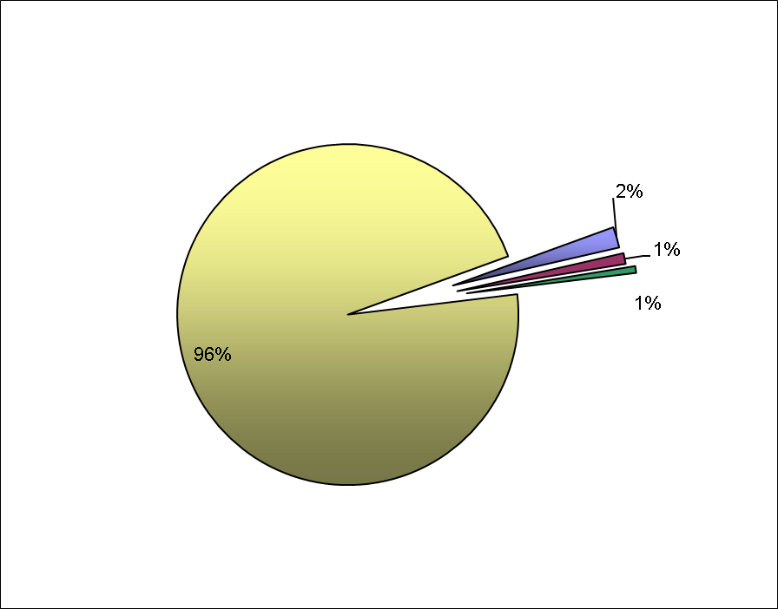
Operations
O1 - Performance Data
Vermont Information Centers Division
Hourly Visitor Counts - 2008…
7 AM to 8 AM: 77,520 Visitors
2% of total (1.97%)
9 PM to 10 PM: 40,405 Visitors
1% of total (1.03%)
10 PM to 11 PM: 25,269 Visitors
< 1% of total (0.64%)
8 AM to 9 PM: 3,792,124 Visitors
96% of total (96.36%)
FY 2008 Total Visitors
3,935,319
-- To support right-sizing decisions
-- During 3 hours (7-8 AM + 9-11 PM), VICD sees 4% of the visitors, and utilizes 18.75% of the resources.

Slide 37
Operations
O2 - Goal
Vermont Information Centers Division
O2 – Strive to maintain average visitor-to-expense ratio of $1.25

Slide 38
Overall Cost Per Visitor FY 2012-2016
Vermont Information Centers Division
Operations
O2 - Performance Data

Slide 39
Operations
O3 - Goal
Vermont Information Centers Division
O3 – Manage clean and well-maintained facilities
  Conduct/document routine quality control inspections and follow-up remediation at all sites.
  Monitor daily reports and maintenance work orders submitted from each site.
  Coordinate with BGS Maintenance Districts for projects requiring major maintenance funding.

Slide 40
Operations
O4 - Goal
Vermont Information Centers Division
O4 – Provide the supervision and oversight to effectively manage all aspects of the program

Slide 41
Operations
O4 - Performance Information
Vermont Information Centers Division
How We Manage -- Supervisory Structure:
Northwest & Northeast (Penny Libercent)
  Alburgh, Georgia North, Bradford, Derby, Lyndon, Waterford
Guilford (Kathy Dowd)
Central District (Lisa Sanchez)
  Sharon, Hartford, Randolph
  Fair Haven
  Liaison oversight for 6 Locations operated by grant/contract (Lisa Sanchez)
    Williston North, Williston South, Georgia South, Bennington, White River Junction, and Berlin*
Four sites operated through contract with local/regional Chambers of Commerce
White River Junction operated with Grant to Town of Hartford.
Berlin is Public-Private Partnership
  Note: 4 Sites Closed in February 2009: Sharon South, Randolph North, Hartford North, Highgate

Slide 42
Operations
O4 - Performance Information
Vermont Information Centers Division
Operations Oversight
Maintain accountability over daily operations
  Morning Check-In Calls
    Verifying opening
    Flag is flying per directive and proper flag etiquette
  Daily Operations Reports
    Submitted electronically from each site
  Security Systems
    Contracted Electronic Monitoring of Openings/Closings
    Employee Panic Buttons
      Isolation – single-staff coverage
      Remote Locations
  Weekly programmatic reports
  Annual Reports

Slide 43
Vermont Information Centers Division
Operations
O5 - Goal
O5 – Market Opportunities to Promote the Vermont Experience to Travelers.
Outreach
  Tell the VICD Story
  Brochures
Partners in Promotion
Marketing
  Entrepreneurial Efforts -- Selling Advertising Space (Lisa Sanchez)
  Frames and Skins Installed at 7 sites
    Derby Line
    Fair Haven
    Guilford
    Randolph
    Sharon
    Hartford
    Bennington

Slide 44
Program Summary…
Vermont Information Centers Division
FY 2009-2016 Changes/Progress
  Continue to Right-Sizing Facilities/Operations
    FY 2009 Closure of 4 sites (February 2009)
      Hartford North, Highgate, Randolph North, Sharon South
    FY 2010 Reduction in Hours of Operation –16 to 12 hours
      7 Sites -- August 16, 2009 -- Derby, Lyndon, Bradford, Waterford, Randolph South, Hartford South, Fair Haven,
      2 Sites -- November 22, 2009 -- Georgia North and South
  Hartford South opened to visitors on October 1, 2012.
  Bennington Welcome Center opened to visitors on October 11, 2013

Slide 45
Program Summary…
Vermont Information Centers Division
Opportunities…
  Partnering with private sector providers
    Public-private partnership at Berlin Exit 7 off Interstate 89.
      Development Agreement in place; anticipated opening in September of 2016.
    Public-private partnership at the Randolph Exit 4 off Interstate 89.
      Development Agreement in place.
  Advertising Sales – Continue marketing efforts to sell advertising panels to businesses at seven VICD sites.
  Federal System Preservation Funds -- facilities network preservation
  Security – RFP for Safety and Security Assessment issued; awaiting awarding of contract.

Slide 46
Program Summary…
Vermont Information Centers Division
Challenges…
  Personnel
    Aging Workforce
      Longer 12-hour shifts a challenge
    Technological Communication/Supervision
    Safety/Isolation
      During FY 2015 and 2016 there were
        Employee safety concerns
        Break-ins and thefts of coffee donations boxes
      Safety/Security Assessment of all VICD locations
        Request for Proposal issued in FY 2016
  Facility Upkeep
    Requires sustainable source of funding for any major maintenance projects.

