Slide 1

Department of Buildings and General Services
2 Governor Aiken Avenue – Montpelier, Vermont
Print Shop
Fiscal Year 2016 - Annual Report
Government Business Services Directorate
September 28, 2016
FY2016 = 7/1/15 – 6/30/16
1
Notes:
1

Slide 2
Mission and Authority
Print Shop
BGS - The employees of Buildings and General Services work together to deliver quality services and provide facilities management, enabling government to fulfill its mission.
Print Shop - Provide state government with economical and convenient access to digital printing and lease copier services.
29 VSA §906 define authority and provisions for providing print services to state offices
2
2
2
2

Slide 3
Program Overview
Print Shop
Centralized program to serve state agencies
  Secure and economical digital printing and finishing services with quick turn-around for the Central Vermont service areas
  Secure and economical transactional data design and digital printing services
    Transitioned from DII to BGS Print Shop in 2008
  Secure mailings with 100% integrity on inserting for health notices, tax documents, etc.
  Print on Demand forms services
  Overnight Legislative Printing services
    Contract awarded to BGS Print Shop in 1997
  Economical lease copier services
3
3

Slide 4
Program Overview
Print Shop
11 full time employees
High speed digital printing
  Over 4,600 publication print jobs processed in FY2016 with an average turn around time of 2.7 days
Fully automated digital workflow for publication printing
  Receive customer files electronically
  Generate proofs in PDF format
  Transmit to customer electronically for approval
  Send approved PDF file to digital printer
4
4
4
100% Process Chlorine Free (PCF) and recycled paper
4

Slide 5

Program Overview
Print Shop
Job Types
  Client Case Files
  Post Cards
  NCR Forms
  Newsletters
  Self-Mailers
  Posters
  Print-on-Demand Forms
    Over 620 active master forms on file
  Transactional Data – over 150 job formats
  Bound or Stitched Reports and Booklets
  Inserting w/assembly & inspection options
5
5
5
5

Slide 6
Program Overview
Print Shop
Transactional data printing
  Merge of mainframe data with forms overlay
    DMV Titles, Licenses, and Registration Renewals
    Checks for Tax and DCF program (OCS, Fuel, etc.)
    Financial reports for Tax, OCS, DMV, and DCF programs
    FY2016 over 32,270 print jobs generated sales of $309,563 (16% of total sales)
6

Slide 7
Program Overview
Print Shop
Transactional data printing
  Mail merge for print/mail jobs
    Word/Excel merges
    PDF/Excel merges (through InDesign)
  Planet Press processing for insert jobs
    Apply sequence number to facilitate QC processes
    Apply barcode to facilitate inserter integrity
      Especially critical to protect confidential information
        Data/information protected by HIPPA
        Taxpayer information protected by IRS
7

Slide 8
Program Overview
Print Shop
Legislative Printing
  2nd shift printing and processing to generate bills, calendars, and journals for the next business day (held contract since 2005)
  FY2016 sales of $68,832 (4% of total sales)
368 Convenience copiers statewide
  Allows agencies and departments to distribute costs over three years
  Avoids capital leases
8
8
8
8

Slide 9
Program Overview
Print Shop
Finishing and Binding Services
  Inserting
    2D Barcode options with 100% integrity
    Selection option for flyer or return envelope
  Folding
  Stapling
  Punching
  Cutting
  Collating
  Tape/Coil Binding
  Laminating
  Foam core mounting
  Packaging
  Numbering
  Pressure fold and seal
9
9
9
9

Slide 10
Key Result Areas
Print Shop
People
Communications
Finances
Operations
10
10

Slide 11
People
P1 - Goal
Print Shop
Provide employees with effective leadership.
  Support BGS Core Values
  Quality and timely evaluations and appropriate feedback
  Fair and deserving recognition through performance rewards and promotions
11
11

Slide 12
People
P1 - Performance Measurement
Print Shop
  Target = 100% of Performance Evaluations completed within 45 days of due date (per VSEA Agreement)

Slide 13
People
P2 - Goal
Print Shop
Provide resources, training, education, equipment, and support required for employees to meet mission requirements.
  Annual Taxpayer Information Training to meet IRS requirements
  Notification of policies, rules, and regulations
  Training on program software and procedures
  Encourage and support networking and professional development
    Summit Classroom and/or On-line University
    Planet Press training with Bell & Howell
  Provide applicable safety training/equipment
    Haz-com, Fire Safety, Back & Lifting Safety, Forklift
    Steel-toe shoes
13
13

Slide 14
Communications
C1 - Goal
Print Shop
C1 – Provide employees with open and honest communications concerning program operations.
  Daily work plan including reminders and notices distributed to all staff
  Share performance measurements at regular intervals
  Share program updates/changes immediately
  Timely and periodic staff meetings with entire team or individuals as appropriate
  Timely and appropriate supervisory feedback
14
14

Slide 15
Communications
C2 - Goal
Print Shop
Provide management with timely and accurate reporting of program operations
  Weekly supervisor’s meeting with Supervisor and Director
  Weekly report to Supervisor
  Periodic meetings related to projects etc.
15
15

Slide 16
Communications
C3 - Goal
Print Shop
Provide state agencies with information and tools to understand and effectively use print products and services
  Website with FAQ and Forms
  Inter/Intra Office Mailings
  Timely follow-up on inquiries
  Periodic flyers and annual calendars to all BGS Postal Center mail drop locations
  Meetings, tours, and conference calls with customers

Slide 17
Communications
C4 - Goal
Print Shop
C4 – Notify state agencies of additions and changes to products and services
  E-mail notices to key contacts
  E-mail notices to Business Managers and Department Heads
  Periodic meetings with various customer groups
17
17

Slide 18
Communications
C5 - Goal
Print Shop
Collaborate with vendors and industry organizations on various services
  USPS – mail piece design
  Xerox, Bell and Howell, VT PCC, and NGPA – best practices
  Wide variety of vendors regarding new technologies

Slide 19
Finances
F1 - Goal
Print Shop
Develop and implement strategies, procedures, and processes to effectively manage program expenditures and revenues.
  Daily verification that job matches data base invoice data
  Sales tracking and internal audit steps to confirm accuracy of invoice data base
  Review and approval of purchases and payments
  Weekly internal inventory of consumables including customer reports for transactional data special stocks (checks, labels, titles, etc.)
  Analyze monthly program financial reports
19
19

Slide 20
Finances
F1 - Performance Measurement
Print Shop
20
20
20
20
Internal Service Funds – Combined Print Shop and Convenience Copier Programs
Target = BREAKEVEN

Slide 21
Finances
F2 - Goal
Print Shop
Develop rates for services to cover program costs
  Considerations for setting rates
    Direct cost of consumables and equipment
    Overhead costs
    Value-added services
      Desktop delivery for Montpelier and Waterbury complex customers
      Single monthly summarized invoice
    Comparison of rates and services to private sector
      Vendors used in the past include: Staples, FedEx/Kinkos, and Minuteman
21
21

Slide 22
Finances
F2 - Program Data
Print Shop
FY2017 - Program Accumulated Deficit Reduction Plan
Projected increase in Print Shop sales | $100,000
Projected personal services savings | $ 30,000
Projected recovery of copiers expensed | $ 20,000
Total Projected Income Increase | $150,000
Accumulated Deficit = $1,449,698
FY2016 = $106,503 Profit - FY2015 = $202,427 Profit - FY2014 = $207,911 Loss
FY2013 = $113,539 Loss
22
22
22

Slide 23
Finances
F-2 Program Information
Print Shop
Rates are based on program cost
  Includes free pick up and delivery for 112 Washington County stops serviced by the BGS Postal Center
Current cost for 8.5 X 11 (100% PCF/recycled paper) | Black Simplex | Black Duplex | Color Simplex | Color Duplex
BGS Print Shop | .038 | .065 | .216 | .421
Over 5,000 for static print runs | .025 | .038 | .114 | .216
23
23
23
23
Outside vendors typically add fee for 100% PCF/recycled paper
Static print run = print jobs requiring no off-line or manual finishing

Slide 24
Operations
O1 - Goal
Print Shop
Effectively operate a centralized digital print shop to provide state agencies with consistently economical and timely printing and finishing services
  Digital Publication Printing (including Print-on-Demand forms)
  Digital Transactional (variable data) Printing (including print/mail)
  Legislative Printing
24
24

Slide 25
Operations
O1 - Program Measurement
Print Shop
25
25
25
25
Target = 25,000,000
Equipment capacity = 84,000,000 (8.5x11 simplex/no finishing)

Slide 26
Operations
O1 - Program Data
Print Shop
26
26
26
26

Slide 27


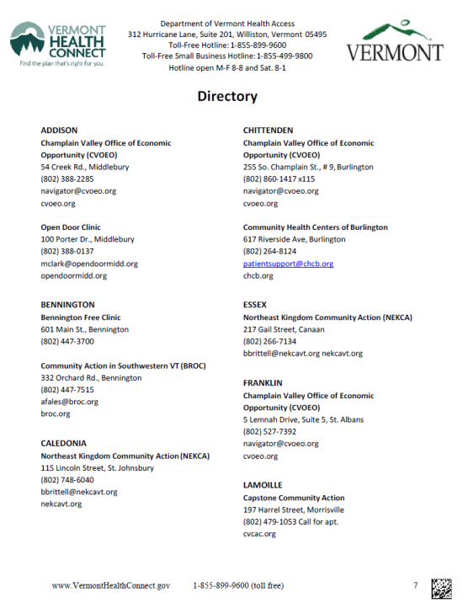
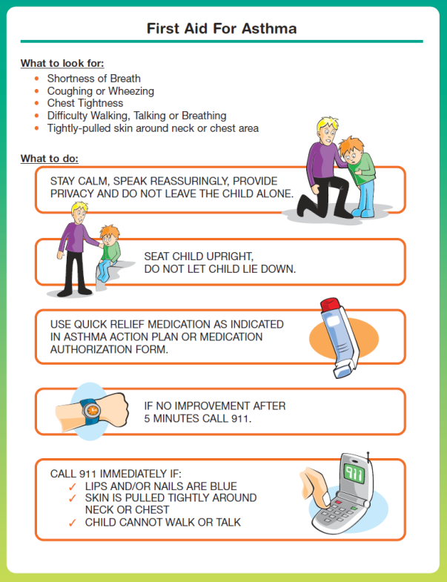




Operations
O1 - Program Information
Print Shop
27
27
27
Job Samples
27

Slide 28
Operations
O2 - Goal
Print Shop
Effectively manage a state-wide copier lease program
  Generate quotes upon request
  Develop 3-year lease agreement for each purchase
  Enter details into copier tracking database for asset tracking and information security (of hard-drives)
  Generate monthly billing data for 368 statewide copiers

Slide 29
Program Summary
Print Shop
29
29
29
29
Successes for FY2016
  VTAX project – Phase II
    Phase II print/mail documents setup and absorbed
    All Tax inserting absorbed
  Sales increased
    All DCF/ADPC printing absorbed
    Vermont Health Connect notices
    Tax print/mail documents

Slide 30
Program Summary
Print Shop
30
30
30
30
Successes for FY2016
  Print/Postal integration – Phase II complete
    Inserters moved to final locations
  Continually evolving QA processes are proving to be very successful
  Planet Press applications developed for 100% integrity inserting
    Monthly DCF/ADPC variable length notice

Slide 31
Program Summary
Print Shop
Program Challenges
  Operations
    Addressing the accumulated deficit
    Customer base limited to state agencies
    Paperless society goals continue to decrease print volumes throughout the industry
31
31
31
31

Slide 32
Program Summary
Print Shop
Program Challenges
  Rates
    Static rates despite increasing salary, equipment, and service costs
  Equipment
    Increasing maintenance and consumable costs (some related to aging equipment)
  Space
    Current storage area located within VSARA Records Warehouse
32
32
32
32

Slide 33
Program Summary
Print Shop
Program Opportunities
  Equipment
    Consider replacement of Bourg collator – limited service available
    Consider lower cost replacements for Xerox printers
    Consider replacing or phasing out LM20 sealers
    Expand inserting services
      Will facilitate phasing out LM20 sealers
      Provide redundancy in services
33
33
33
33

Slide 34
Program Summary
Print Shop
Program Opportunities
  Workflow and Services
    Consider software purchase to streamline workflows and eliminate reliance on outside IT operations to correct forms driven workflow
  Expand customer base
    Work with Postal Center to educate customers on print/mail design and potential cost savings
    VTax – Phase III project
34
34
34
34

Slide 35
Program Summary
Print Shop
Program Opportunities
  Expand print/mail jobs processed through Planet Press
    Reduces integrity issues with insert jobs
  Increase jobs included in automated billing process
    Eliminate labor intensive manual billing
35
35
35
35

Slide 36
Customer feedback
Print Shop
“You guys are awesome. Thank you so much!”
  Judy Eastman, MV Unit Supervisor
  Department of Motor Vehicles
“Thanks again for your speedy, excellent work, guys!”
  Rochelle Skinner, Parks Sales & Service Manager
  Vermont State Parks
“As always, I thank you all at the Print Shop and Postal Center for helping us with a print and mail issue, I appreciate the help with problem solving, and the support.”
  John Booth
  Treasurer’s Office
36
36
36
36

Slide 37
Customer feedback
Print Shop
“You have no idea how much we appreciate the quick turn-around on these!!
Thank you very much!!”
  Christian Gilcris, Operations Unit
  VT Office of Child Support
“You ALL are FABULOUS. You make my job so much easier. I can’t tell you how much I appreciate the cooperation and all around professionalism…I know I ask for things at the drop of a hat and you always deliver.”
  Janet Paré, Benefits Program Administrator
  Agency of Human Services
37
37
37
37

Slide 38
Customer feedback
Print Shop
“Great job everybody!...It would have crippled us right now if we didn’t have your help on this. Thank you so much!! You guys are the BEST!”
  Tammy Sink, Director Application & Document Processing Center
  Department for Children and Families
“THANK YOU SO MUCH… I thought it didn’t hurt to ask. I am glad it worked out. There will [be] lots of happy Vermonters tomorrow.”
  Cindy Olson
  Vermont Health Connect
38
38
38
38

Slide 39
Customer feedback
Print Shop
“We haven’t spoken recently but you have done several posters for us recently, the Cancer Plan, ADAP Substance Abuse Prevention. I am so pleased with how they look I often suggest that people consider posters when we are working on other communication pieces. You are fast and produce a good product.”
  Kathleen Horton, Communication & Marketing Coord.
  Vermont Department of Health
“Thanks for being thorough. And thanks for the nice print job. You folks do good work over there.”
  Erik Filkorn
  Vermont Agency of Transportation
39
39
39
39

Slide 40
Customer feedback
Print Shop
“I just heard that you figured out a way to add barcoding to ESD’s notice runs. F A N T A S T I C news!
I’d like to know more about what you did/how you did this in case there’s a learning opportunity here. To think you fixed this quickly vs. taking up “6-8 months” of IT time is nearly miraculous.
Thank-you Thank-you Thank-you!”
  Bob Hammerl
  DCF/ESD/ADPC
40
40
40
40

