Slide 1
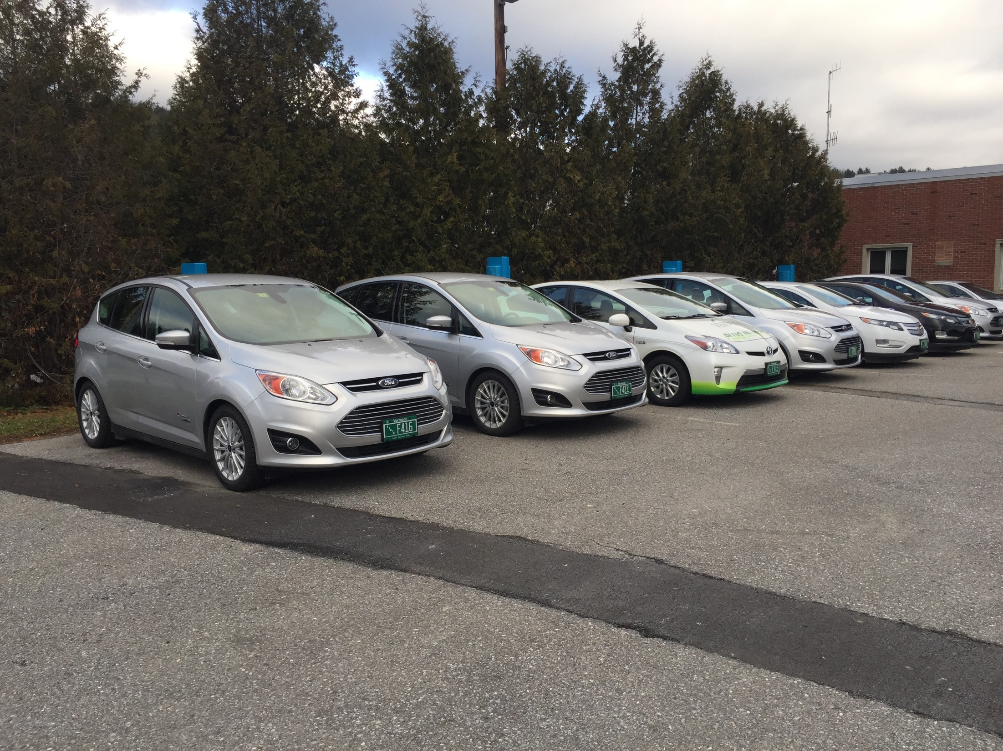
Buildings and General Services Government Business Services Fleet Management Services Annual Report FY 2017

Slide 2
Program Summary
Fleet Management Services (FMS) provides centralized management and control of the State’s vehicles, except for those exempt by statute or by Commissioner of Buildings & General Services.
Vehicle transportation is vital to accomplishing many of the tasks of state government, and vehicles serve a wide variety of needs–from occasional administrative travel to routine off-road use. FMS is committed to providing state agencies and departments with appropriate, well-maintained vehicles, and the necessary tools and resources, to allow them to meet their unique missions.

Slide 3
Authority
Administrative Bulletin 2.3 outlines State policy regarding the provisions and use of state-owned motor vehicles within the constraints of the law as reflected in 3 V.S.A. §217(a):
“No state department or agency, board, or commission, except the governor, the
commissioner of the department of buildings and general services, or the commissioners of
the departments of fish and wildlife and public safety for use of employees who are sworn
law enforcement officers, may maintain or provide passenger vehicles subject to such
exceptions as may be made by the commissioner of buildings and general services in
circumstances where there is documented evidence of necessity based upon the
requirements or conditions of individual state programs.”

Slide 4
Mission
To provide agencies and departments with safe, economical vehicles for use on state business, and reduce the environmental impact of state travel.

Slide 5
Goals
Provide safe, economical vehicles to agencies and departments
Preventive maintenance compliance
Manufacturer recommended maintenance completed within 30 days or 1,200 miles when due
Manufacturer recalls
Recall work addressed within 30 days from notice or parts availablility
.
Vehicles procured at lowest possible cost, and right-sized
Formal justification process used to right-size vehicles and the overall fleet
Vehicle procurement considers total cost of ownership, highest fuel economy, and lowest tailpipe emissions
Educate and inform employee travel options
Encourage use of trip calculator to determine lowest cost travel option
Annually inform agencies and departments of high mileage drivers and potential savings available
Reduce environmental impact of state travel
Reduce emissions, increase fuel efficiency, and reduce fuel consumption
Vehicles matches expected use (right-size)
Deploy plug-in electric hybrid and all-electric vehicles, when feasible
Procure vehicles with the highest fuel economy, and lowest tailpipe emissions, when economical
Inform agencies and departments of excessive idling when telematics data is available

Slide 6
Program Revenues/Expenses The program operates as an Internal Service Fund. The objective to generate sufficient revenue to cover operating expenses, while providing vehicles at the lowest rate possible. Fleet lease rates were lowered at the onset of FY 2016 to adjust the program fund balance, and pass savings back to departments.

Slide 7
Monthly Rate Comparison Fleet Rates vs. State Contract Rental Rates
 | Monthly State Rental Contract Rate | Monthly Fleet Vehicle Lease Rate | Cost Savings | % Saved
Intermediate Sedan | $744 | $282 | $462 | 62%
Hybrid Sedan | $947 | $326 | $621 | 66%
Intermediate 4WD SUV | $1,095 | $360 | $735 | 67%
1/2 Ton 4WD Truck | $1,061 | $415 | $646 | 61%
Average for Vehicle Classes | $3,847 | $1,383 | $2,464 | 64%
Average Monthly Fleet Rate Savings compared to Average Monthly Contracted Rates using 2017 rates is 64% savings.

Slide 8
Lease Vehicle Assignments The program provides long-term lease vehicles to agencies and departments whose travel history indicates that use of centralized fleet vehicles will result in savings over the federal mileage reimbursement rate, or their mission justifies need for a vehicle.
27 Departments

Slide 9
Motor Pool Utilization Motor pools are located at various state campuses throughout the state, and provide daily rental cars to all employees for state travel. Utilization percentages are based on the number of rental days the vehicles are in use compared to the total number of rental days the vehicles are available. The program aims to achieve 65% utilization at each motor pool location to meet rental demand, while generating sufficient revenue to cover operational costs. The program is successful when the average cost per mile paid by departments is less than the federal mileage reimbursement rate. In FY 2017, the average cost per mile paid by departments to use motor pool was $0.08 less than the mileage reimbursement rate, saving the State approximately $65,394.
 | Montpelier – State St | Montpelier – Green Mtn Dr | Montpelier – Natl Life Dr | Waterbury | Burlington – Cherry St | Burlington – Pearl St (opened Oct 2016) | Rutland | Springfield (opened April 2017)
Utilization Percent | 67% | 39% | 54% | 45% | 76% | 49% | 56% | 34%
Miles Traveled | 226,579 | 251,438 | 84,002 | 41,097 | 110,455 | 8,386 | 90,665 | 4,809
Rental Bookings (Days) | 2,034 | 2,121 | 705 | 454 | 1,325 | 91 | 1,103 | 43
Rental Availability (Days) | 3,045 | 5,396 | 1,314 | 1,000 | 1,751 | 186 | 1,957 | 128
Number of Vehicles (end of FY17) | 12 | 21 | 4 | 4 | 8 | 1 | 8 | 2
Average Cost per Mile: $0.46
Total Motor Pool Miles Driven: 817,431
Total Number of Vehicles: 60
Total Rental Days for FY17: 7,876
Combined Motor Pool Utilization – 53%

Slide 10
Fleet Composition The program right-sizes vehicles by matching the expected use with the most economical, fuel-efficient, and lowest emissions vehicle possible. Administrative travel and passenger transport is best accomplished by partial- or zero-emission sedans, and larger vehicles reserved for bulky or heavy cargo transport, off-road travel, or other special needs.
FY17 – Inventory as of July 3, 2017
includes 48 transitioning new/retired units

Slide 11
Fuel Purchases The program supports the reduction of greenhouse gas emissions by assigning the lowest emission, most fuel efficient vehicle, which meets expected needs established by agencies and departments through a justification review. In addition to vehicle fuel economy, travel distance primarily drives fuel purchases. The program aims to increase the average miles traveled per fuel gallon purchased.
*Mileage data is collected from driver reports, which may contain inaccurate entries.
Obvious outliers are removed, however mileage data is considered approximate.

Slide 12
Reimbursed Travel & Fleet Utilization The program’s mission is to provide fleet vehicles to agencies and departments when it will result in savings over the federal mileage reimbursement rate, or when their mission requires a fleet vehicle. Our goal is to reduce travel performed in personal vehicles at the full reimbursement rate, when using a fleet vehicle is more cost effective.
Fleet mileage data is collected from driver reports, which may contain inaccurate entries. Obvious outliers are removed, however mileage data is considered approximate.
Vehicles exempt from the Fleet program are not included in Fleet program reports.

Slide 13
High Mileage Drivers As a cost saving strategy, the program informs agencies and departments of their high mileage drivers based on expense data and fleet rates from the previous fiscal year, and recommends using the lowest cost option. An employee is considered a high mileage driver when their annual mileage reimbursements exceed the cost for their department to lease a fleet sedan. The current annual threshold is 10,000 miles, while in past years the threshold has been as much as 14,000 miles. Fleet lease rates were reduced July 2015, which now makes using a fleet sedan more economical at a much lower annual threshold.
Cost of High Mileage Drivers FY 2013 - 2017
Fiscal Year (Number of Drivers)

Slide 14
Locations with Highest Mileage Reimbursements The program seeks to increase the use of fleet vehicles at these locations, by making cars available through a motor pool, when possible. This reimbursement data is only one consideration in selecting potential motor pool locations; available parking, partnerships with departments for dispatch, and other factors are considered.
FY 2017 Employee Full-Rate Mileage Reimbursements by Departing Location

Slide 15
Fleet Disposal: Return of Investment The program aims to achieve a 25% average return of investment for fleet vehicles*, which is the return on investment attained by “Elite” fleets, according to Government Fleet magazine.¹ The program’s replacement planning and remarketing strategies are designed to maximize the return of investment.
Average resale return of original purchase amount
*Vehicles disposed by insurance settlement, have a salvage title, or were transferred to program after purchase, are excluded from ROI calculation.
1. Thi Doa, Author. “Elite Fleets Continue Tradition of Excellence.” Government Fleet. Published July 2013.
http://www.government-fleet.com/article/story/2013/07/elite-fleets-continue-tradition-of-excellence.aspx.

Slide 16
Plug-In Electric Vehicles (Hybrid and Full-EV) The 2016 State Agency Energy Plan and Vermont Zero Emission Vehicle Action Plan establish a goal to convert 25% of light-duty state fleet vehicles to plug-in electric by 2025. Accordingly, Fleet Management Program must continue working with agency operations staff to identify opportunities to add more plug-in hybrids, and all-electric vehicles. Within the 2016 Agency Energy Implementation Plan, the Fleet Management Program has also committed to adding 5 plug-in electric vehicles each year, to help meet the goal to reduce greenhouse gas emissions.
FY 2017
 | Fleet Inventory | Avg Vehicle Purchase Cost | Avg Fuel Economy | Avg Miles Driven per Vehicle | Avg Fuel Consumed Per Vehicle | EPA Gas Only Fuel Economy Avg Estimate | All Electric Range on Full Charge
Toyota Prius (plug-in hybrid | 3 | $28,764 | 43 MPG | 10,731 | 250 gal | 49 MPG | 0-6 mi.
Ford C-Max Energi (plug-in hybrid electric) | 16 | $29,753 | 36 MPG | 12,048 | 329 gal | 36 MPG | 0-19 mi.
Chevy Volt (plug-in hybrid electric) | 6 | $33,283 | 48 MPG | 9,959 | 218 gal | 40 MPG | 36-49 mi.

Slide 17
Fleet Vehicle Accident Losses Vehicle accident repairs are covered with program funds, with exception of a few special-use vehicles. The driver’s agency or department is only responsible to pay a minimal deductible per incident. FMS pursues and manages claims to recover damages caused by a negligent third party, through the State’s contracted vendor for third-party administrative services.
Summary:
Accident damages $102,237
Damage recovery - $ 27,523
Department deductibles - $ 27,205
Net Cost to FMS $ 47,509
Total Accidents – 96

Slide 18
Exempt Vehicle Inventory The program is responsible to maintain the official inventory of all state-owned vehicles per Agency of Administration Bulletin 2.3. Agencies and departments granted exemption from the program are required to report annually on their state vehicles, with the exception of Agency of Transportation and Department of Public Safety, which are managed and reported independently.
Inventory as of July 2017

Slide 19
State-Owned Vehicle Inventory Based on data collected from agencies and departments, the number of state-owned vehicles has steadily increased since FY 2011, some of which is likely attributable to efforts to shift state travel to lower cost fleet vehicles.
State-Owned Vehicle Inventory History
 | FMS Vehicles | Exempt Vehicles | Total Vehicles
FY 2011 | 504 | 1193 | 1697
FY 2012 | 534 | 1208 | 1742
FY 2013 | 537 | 1218 | 1755
FY 2014 | 564 | 1247 | 1811
FY 2015 | 639 | 1250 | 1889
FY 2016 | 668 | 1250 | 1918
FY 2017 | 734 | 1240 | 1974

